Slide 1

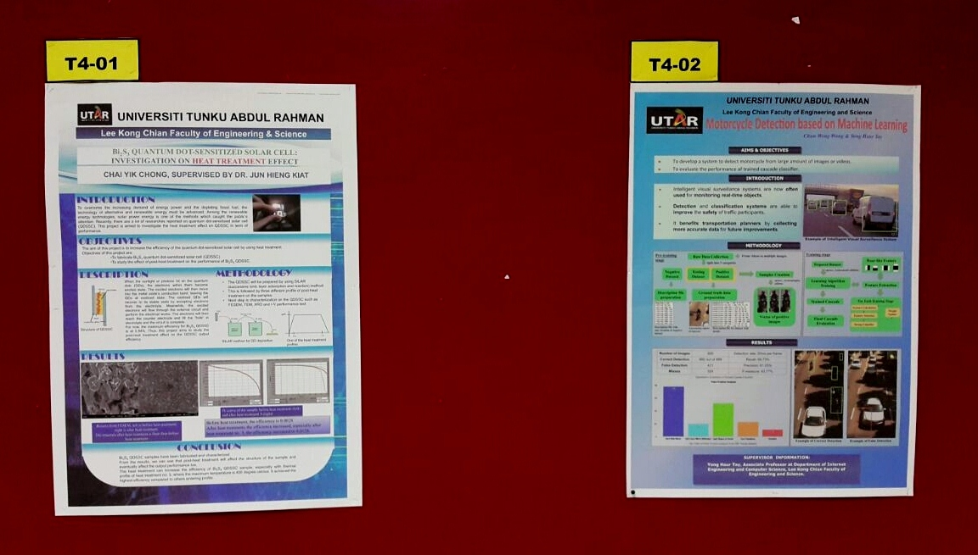
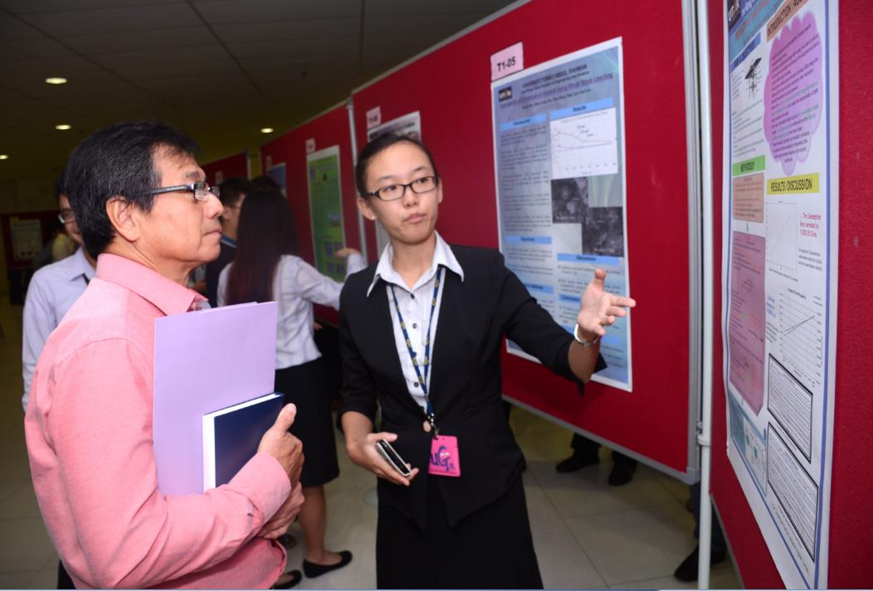

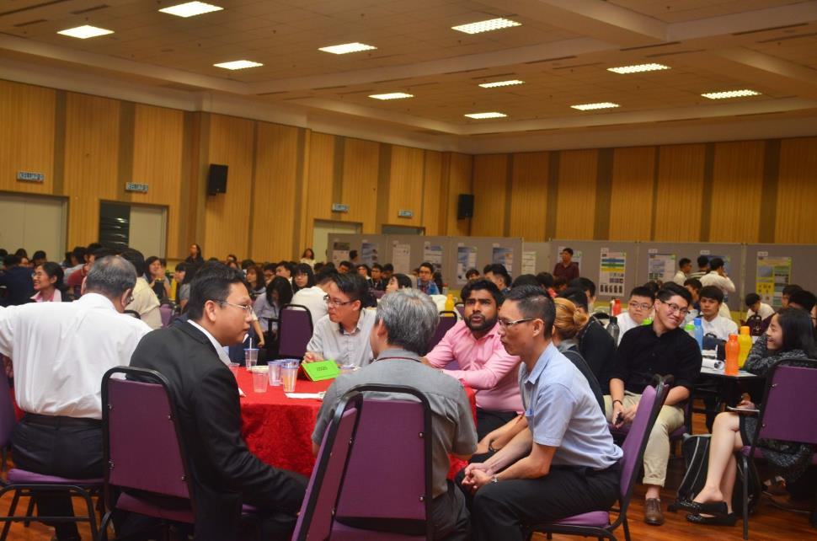
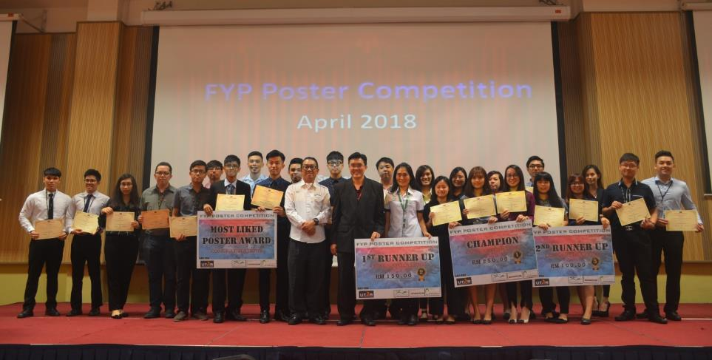

UNIVERSITI TUNKU ABDUL RAHMAN
Lee Kong Chian Faculty of Engineering and Science
The Title of the Poster, in Bold Letters
Student name, Supervisor name and Co-supervisor name
INTRODUCTION
The title must accurately reflect the subject matters. The Introduction section should provide a clear overview or background of the project. The purpose and objective must be clearly and accurately explained in the Objective section. The information should be relevant to the stated area/track .
(You are free to change the font, text size, arrangement and number of figures/tables in the template. When inserting graphics or equations, keep the resolution high. You are also free to use coloured backgrounds, but they generally reduce readability)
Figure 1: Only Portrait A1 layout (594 mm x 841 mm) is allowed for poster.
OBJECTIVES
This template provides a guideline for the preparation of posters for LKC FES FYP poster competition.
The poster must be saved in Portrait A1 (594 mm × 841 mm) format.
Submission of poster
Poster assessment by FYP supervisors
(Preliminary assessment)
Shortlisting of poster by poster review committee and FYPC
METHODOLOGY
Announcement of shortlisted posters
Method must be very well stated. The graphics and visuals should convey the intended information which improve understanding of the content. The content should be clear, easy to understand and convey the intend without verbal explanation. Besides, it should be well organized and convey the intend without any narration.
(You may refer to some of the attached examples for reference)
Poster presentation by students of all shortlisted posters
(Assessed by special panel of judges)
Winners from each track will receive prizes and certificates
Winner of the most-liked poster will receive prize and certificate
All shortlisted posters will receive certificate of participation
Figure 2: SOP for FYP Poster Competition
RESULTS & DISCUSSION
Table 1: FYP Poster Submission Details
T
DONT FORGET TO ADD
MORE GRAPHICS/ VISUALS IF NEEDED.
REMOVE ALL THE EXTRA /UNWANTED PART(S).
Item | Details
Submission Deadine | As announced
Poster Tracks | Categorized by department
Poster Design Reference | How to make an academic poster in PowerPoint: https://youtu.be/_WnhoIbfcoM
Figure 4: Student presenting her FYP Poster.
Figure 3: Software and tools for poster design
The Most-Liked Poster Award: Vote for your favourite poster. Log on to LKCFES FYP Website for the voting link
Figure 5: Winners
Figure 6: Prize giving ceremony.
CONCLUSION
The conclusion of your poster should be the climax of your work, and needs to address the main aims and objectives of the project.

